Slide 1
SQL Injection Attack
Bhavik Patel

Slide 2
Vulnerability Assessment
Vulnerability assessment methodology is a systematic approach to identifying and evaluating security flaws in systems, applications, or networks.
Types of database vulnerabilities (e.g., unauthorized access, data breaches, SQL injection).
Impact of database vulnerabilities on organizations.

Slide 3
SQL injection attack
What is SQL Injection?
Definition of SQL injection.
How attackers exploit vulnerabilities in user input fields.
Common targets: login forms, search bars, and URL parameters.

Slide 4
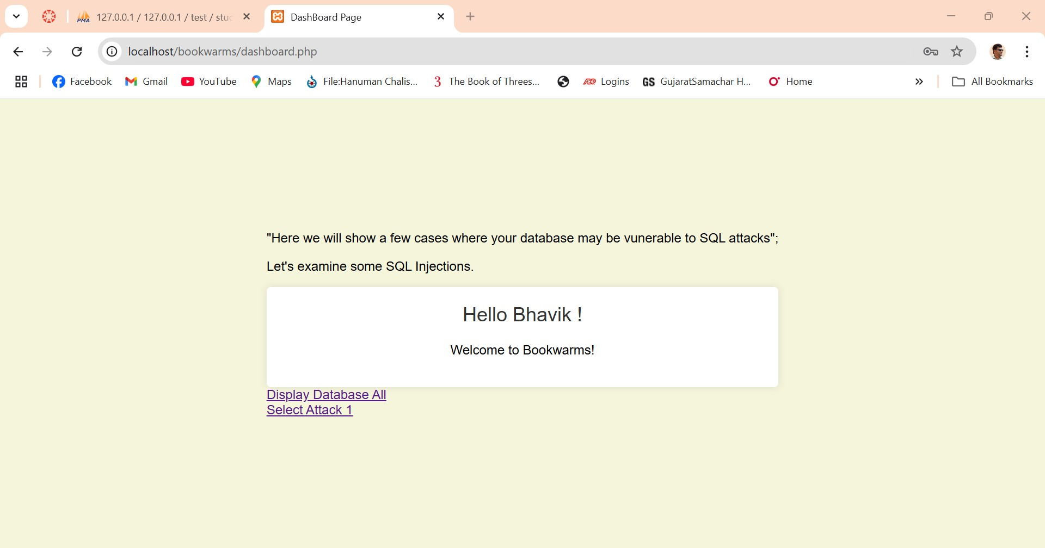
Project and Implementation
I want t create book review platform called Bookwarms.
It is website that customer provide feedback of the book they like.
Currently I am working on the login page of the book.
I am successfully create login page that integrated with database.
This page not secure to login because it is vulnerable for SQL injection attack.

Slide 5
Secure website login from SQL injection.
Validate & Sanitize User Input.
Limit Database Permissions.
Hash and Salt Passwords.
Regular Security Testing.
Web Application Firewall (WAF).

Slide 6

Questions

Slide 7
Reference
Ahmetoglu, H., & Das, R. (2022). A comprehensive review on detection of cyber-attacks: Data sets, methods, challenges, and future research directions. Internet of Things, 11, 100615. https://doi.org/10.1016/j.iot.2022.100615
Sajjadi, S. M. S., & Tajalli Pour, B. (2013). Study of SQL injection attacks and countermeasures. International Journal of Computer and Communication Engineering, 2(5), 381–384. Retrieved from: https://www.ijcce.org
Basu, S., & Jain, S. (2024, November 1). Types of vulnerability scanning. Security Audit. Retrieved from: https://www.getastra.com/blog/security-audit/vulnerability-scanning-types
Kindy, D. A., & Pathan, A.-S. K. (2012). A detailed survey on various aspects of SQL injection in web applications: Vulnerabilities, innovative attacks, and remedies. Retrieved from: https://doi.org/10.48550/arXiv.1203.3324
National Institute of Standards and Technology (NIST). (2020). Guide to cyber threat information sharing (NIST Special Publication 800-150). U.S. Department of Commerce. Retrieved from: https://nvlpubs.nist.gov/nistpubs/SpecialPublications/NIST.SP.800-150.pdf
Lan, F., & Zhang, J. (2017, December 8). Database security—SQL injection. Retrieved from https://www.cs.rochester.edu/courses/261/fall2017/termpaper/submissions/04/Paper.pdf
digininja. (n.d.). Damn Vulnerable Web Application (DVWA) [GitHub repository]. GitHub. Retrieved from: https://github.com/digininja/DVWA
Damele, B. (n.d.). sqlmap: Automatic SQL injection and database takeover tool [Computer software]. GitHub. Retrieved from: https://github.com/sqlmapproject/sqlmap

